Slide 1
Learning with Kernels
CS771: Introduction to Machine Learning
Purushottam Kar

Slide 2
Non-linear Learning
These are learning techniques that involve non-linear models
Classifiers with non-linear decision boundaries
Regressors that predicts the label using non-linear functions
Dim-redn that reveal if data was lying on a low-dim curved surface
We have actually seen a few non-linear learning techniques already
kNN, learning with multiple prototypes are all capable of learning non-linear decision boundaries, non-linear functions etc
Also saw generalized linear models in the last class
These are nice and valuable but much more powerful methods exist
Will study two such methods – kernel learning and deep learning
Start with kernel learning

Slide 3
When should I use kernels?
Kernel methods are a good option to try whenever linear models do a poor job on our data
A non-linear classifier is needed
Linear classifier fits excellently!
All linear classifiers would do horribly!
Even with a few outliers, a linear classifier still fits decently

Slide 4


When should I use kernels?
Kernel methods are a good option to try whenever linear models do a poor job on our data
All linear regressors would do horribly!
A non-linear regressor is needed
Linear regressor fits excellently!
Even with some noise, linear regressor still fits very well!

Slide 5
When should I use kernels?
Kernel methods are a good option to try whenever linear models do a poor job on our data
However, k-means always produces linear cluster assignment boundaries
Non-linear cluster assignment boundaries needed
K-means clusters data very well
K-means would do very badly

Slide 6
When should I use kernels?
Kernel methods are a good option to try whenever linear models do a poor job on our data
(P)PCA would do very well
Data does lie close to a low-dim hyperplane
PCA would do a bad reconstruction
No low-dim hyperplane approximates data well
Data actually lies close to a smooth low-dim (but non-linear) surface

Slide 7
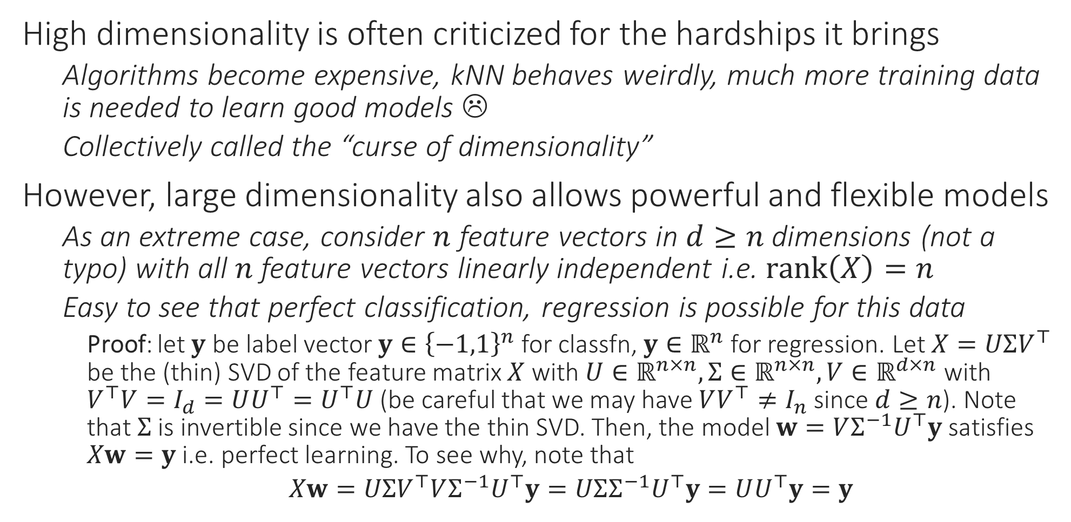
The Blessing of Dimensionality
High dimensionality is often criticized for the hardships it brings
Algorithms become expensive, kNN behaves weirdly, much more training data is needed to learn good models ☹
Collectively called the “curse of dimensionality”
However, large dimensionality also allows powerful and flexible models
As an extreme case, consider $n$ feature vectors in $d≥n$ dimensions (not a typo) with all $n$ feature vectors linearly independent i.e. $rank\left(X\right)=n$
Easy to see that perfect classification, regression is possible for this data
Proof: let $y$ be label vector $y∈{\left\{−1,1\right\}}^{n}$ for classfn, $y∈ℝ^{n}$ for regression. Let $X=UΣV^{⊤}$ be the (thin) SVD of the feature matrix $X$ with $U∈ℝ^{n×n},Σ∈ℝ^{n×n},V∈ℝ^{d×n}$ with $V^{⊤}V=I_{d}=UU^{⊤}=U^{⊤}U$ (be careful that we may have $VV^{⊤}≠I_{n}$ since $d≥n$). Note that $Σ$ is invertible since we have the thin SVD. Then, the model $w=VΣ^{−1}U^{⊤}y$ satisfies $Xw=y$ i.e. perfect learning. To see why, note that
$Xw=UΣV^{⊤}VΣ^{−1}U^{⊤}y=UΣΣ^{−1}U^{⊤}y=UU^{⊤}y=y$

Slide 8

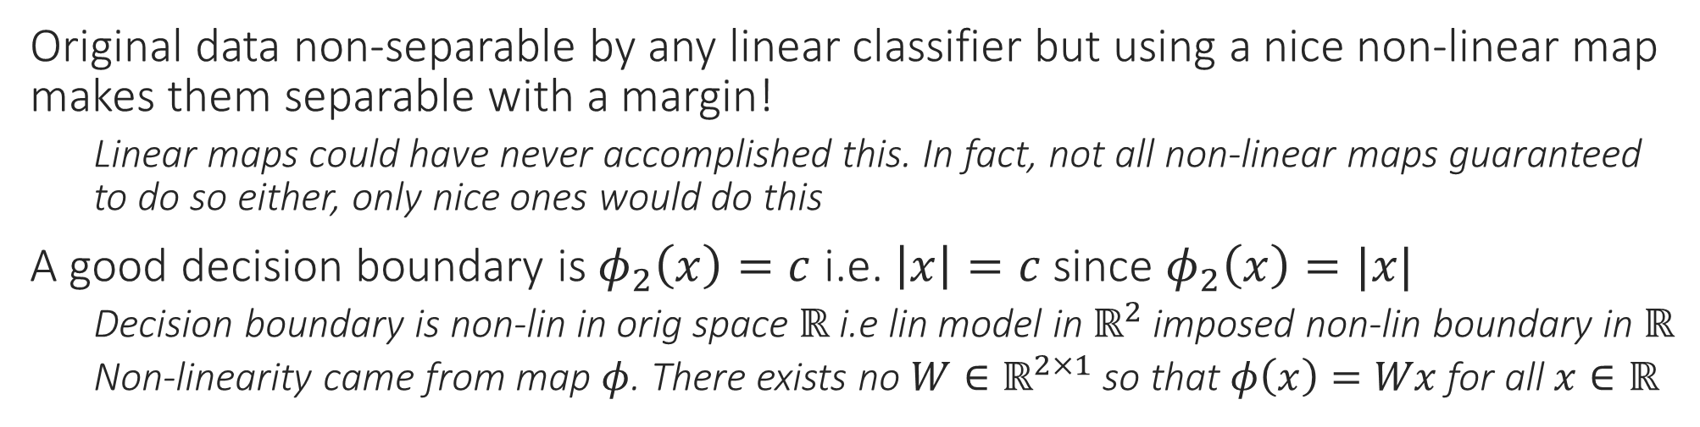
Non-linear Classification
Original data non-separable by any linear classifier but using a nice non-linear map makes them separable with a margin!
Linear maps could have never accomplished this. In fact, not all non-linear maps guaranteed to do so either, only nice ones would do this
A good decision boundary is $φ_{2}\left(x\right)=c$ i.e. $\left|x\right|=c$ since $φ_{2}\left(x\right)=|x|$
Decision boundary is non-lin in orig space $ℝ$ i.e lin model in $ℝ^{2}$ imposed non-lin boundary in $ℝ$
Non-linearity came from map $φ$. There exists no $W∈ℝ^{2×1}$ so that $φ\left(x\right)=Wx$ for all $x∈ℝ$

Slide 9

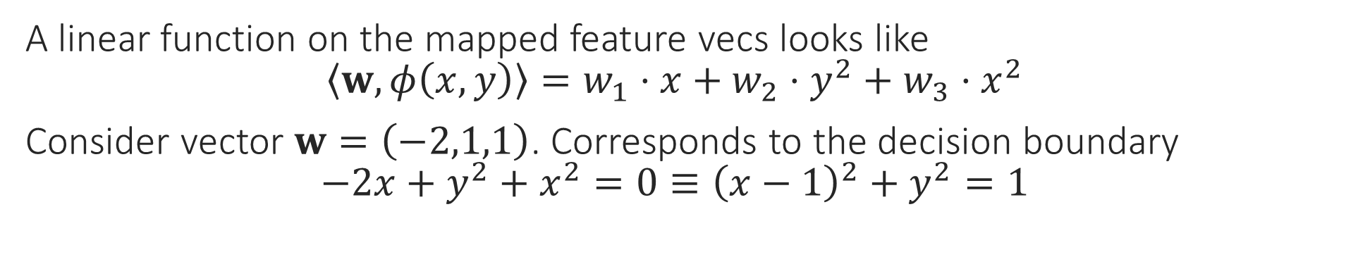
Non-linear Classification
A linear function on the mapped feature vecs looks like $\left\langle w,φ\left(x,y\right)\right\rangle =w_{1}⋅x+w_{2}⋅y^{2}+w_{3}⋅x^{2}$
Consider vector $w=\left(−2,1,1\right)$. Corresponds to the decision boundary $−2x+y^{2}+x^{2}=0≡{\left(x−1\right)}^{2}+y^{2}=1$

Slide 10
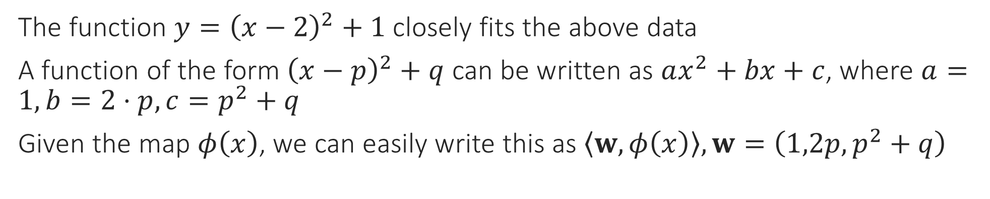
Non-linear Regression
The function $y={\left(x−2\right)}^{2}+1$ closely fits the above data
A function of the form ${\left(x−p\right)}^{2}+q$ can be written as $ax^{2}+bx+c$, where $a=1,b=2⋅p,c=p^{2}+q$
Given the map $φ\left(x\right)$, we can easily write this as $\left\langle w,φ\left(x\right)\right\rangle ,w=\left(1,2p,p^{2}+q\right)$

